Slide 1
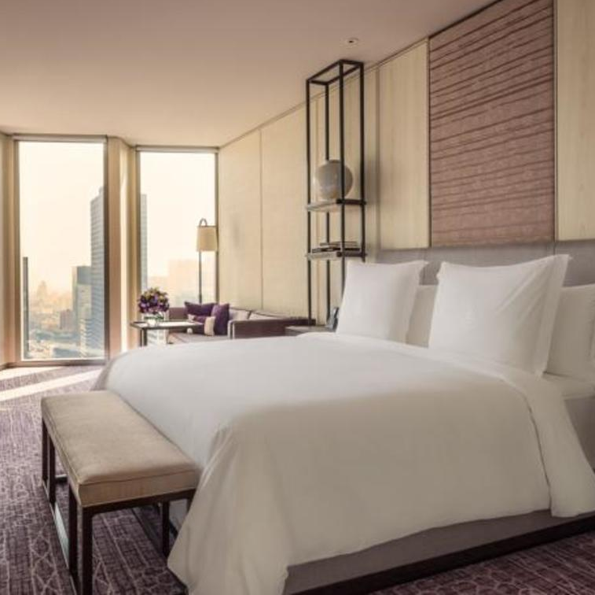
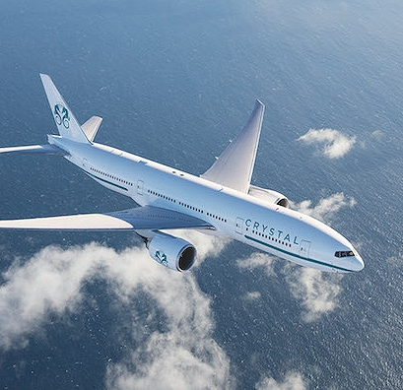

5 Star Accommodations (7 nights), Deluxe Ocean-view (2 rooms) Daily Breakfast
CA Non-stop Airfare from Winnipeg
$3000 Gift Card for shopping &restaurant

